Slide 1
Year:2022-23
Subject: Ethical Hacking and Forensics(EH&F)
Semester :VI
Module 1, Part1
Class: D15B
By
Dr Manoj K Sabnis
Notes:
1

Slide 2
EH& F…….. module 1…Part1
1)Course objectives……
The course is so designed with a aim of..
1.1)To understand the concept of cybercrime and principles behind ethical hacking.
1.2 To explore the fundamentals of digital forensics, digital evidence and incident response.
1.3) To learn the tools and techniques required for computer forensics.
1.4) To understand the network attacks and tools and techniques required to perform network forensics.
1.5) To learn how to investigate attacks on mobile platforms.
1.6) To generate a forensics report after investigation.
2

Slide 3
EH& F…….. module 1…Part1
2)Course outcomes……
On successful completion, of course, learner/student will be able to:
2.1) Define the concept of ethical hacking. (L1)
2.2) Recognize the need of digital forensics and define the concept of digital evidence and incident response. (L1,L2)
2.3) Apply the knowledge of computer forensics using different tools and techniques. (L1,L2,L3)
2.4) Detect the network attacks and analyze the evidence. L1, L2,L3,L4
2.5) Apply the knowledge of computer forensics using different tools and techniques. (L1,L2,L3)
3

Slide 4
EH& F…….. module 1…Part1
2)Course outcomes……cont
On successful completion, of course, learner/student will be able to…cont
2.6) List the method to generate legal evidence and supporting investigation reports L1,L2
3) Syllabus…….
3.1)Module1:Cybercrime and Ethical Hacking
Introduction to Cybercrime, Types of Cybercrime, Classification of Cybercriminals, Role of computer in Cybercrime, Prevention of Cybercrime. Ethical Hacking, Goals of Ethical Hacking, Phases of Ethical Hacking, Difference between Hackers, Crackers and Phreakers, Rules of Ethical Hacking. (CO1)
4

Slide 5
EH& F…….. module 1…Part1
3.2) Module 2: Digital Forensics Fundamentals
Introduction to Digital Forensics, Need and Objectives of Digital Forensics, Types of Digital Forensics, Process of Digital Forensics, Benefits of Digital Forensics, Chain of Custody, Anti Forensics. Digital Evidence and its Types, Rules of Digital Evidences. Incident Response, Methodology of Incident Response, Roles of CSIRT in handling incident. (CO2)
3.3) Module 3:Computer Forensics
Introduction to Computer Forensics, Evidence collection (Disk, Memory, Registry, Logs etc), Evidence Acquisition, Analysis and Examination(Window, Linux, Email, Web, Malware) , Challenges in Computer Forensics, Tools usedin Computer Forensics. (CO3)
*
5

Slide 6
EH& F…….. module 1…Part1
3.4) Module 4:Network Forensics
Introduction, Evidence Collection and Acquisition (Wired and Wireless), Analysis of network evidences(IDS, Router,), Challenges in network forensics, Tools used in network forensics. ( CO4)
3.5)Module 5: Mobile Forensics
Introduction, Evidence Collection and Acquisition, Analysis of Evidences, Challenges in mobile forensics, Tools used in mobile forensics ( CO5)
3.6) Module 6: Report Generation
Goals of Report, Layout of an Investigative Report, Guidelines for Writing a Report, sample for writing a forensic report. (CO6)
6

Slide 7
4) What is cyber crime…
4.1) Criminal misconduct committed using a computer through a network
4.2)The computer can be the object used to commit the crime.
4.3) Computer is used as a weapon on some applications using the computer at the hacker’s end
4.4)The computer can be the subject on which the crime is committed….on its hardware or software
4.5)The computer is an object or subject that has to be accessed
4.6)It cannot be accessed physically.
4.7)It is usually accessed remotely.
4.8) The source or hacker’s machine accesses the target machine using the internet network.
4.9) Although some cybercrimes are intended to cause harm to
the victim, the vast majority are committed for financial
gain.
7

Slide 8
EH& F…….. module 1…Part1
Qualities of cyber criminal
1. good knowledge of computer hardware, software, computer network, data transfer, protocols and so on.
2. So to prevent cyber crime, the person should be one step ahead with complete knowledge of computer and its networks
8

Slide 9
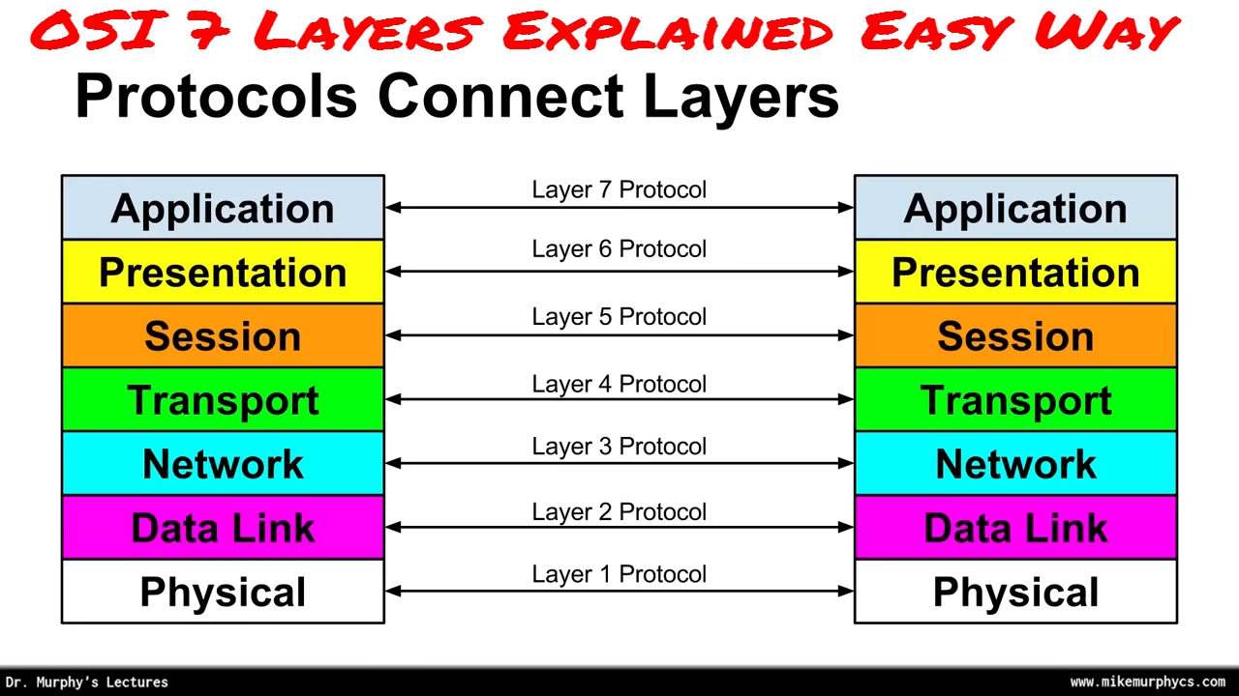
EH& F…….. module 1…Part1
6) source and destination computer interaction on network
Concusion…
9

Slide 10
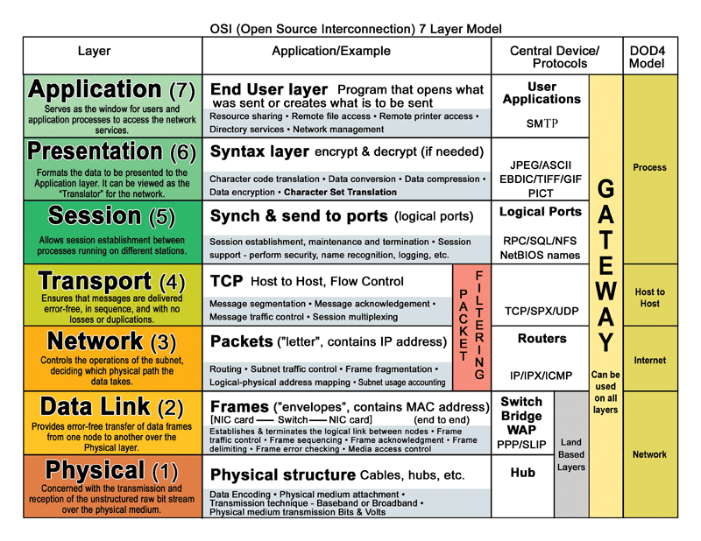
EH& F…….. module 1…Part1
6) source and destination computer interaction on network
10

Slide 11
THANK YOU
For
A
Patient
Hearing
*
11

